Slide 1
Python:
Configuration!
Lesson 9

Slide 2
What have we done so far?
Print statements
Data types
Comments
Variables
Strings (and related functions)
Operators
Arithmetic, Comparison, Bitwise, Logical, Assignment
Conditional Statements
If, if-else, if-elif-else
Functions
Structure of functions
Built in functions
Lambdas

Slide 3


Intro: Python and Pycharm

Slide 4
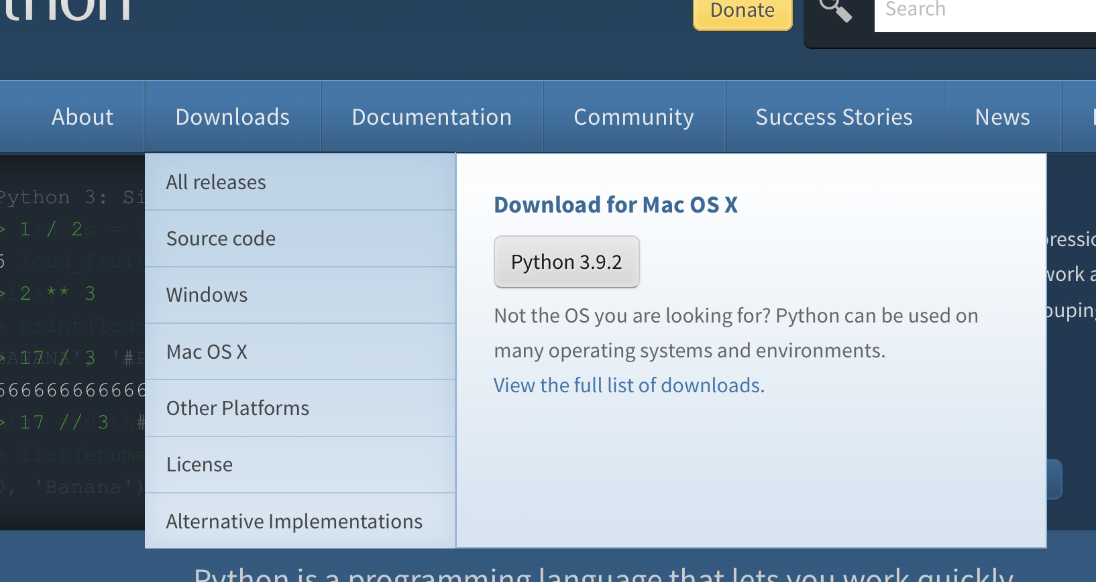
Downloading Python
https://www.python.org

Slide 5

Downloading Pycharm
https://www.jetbrains.com/pycharm/

Slide 6
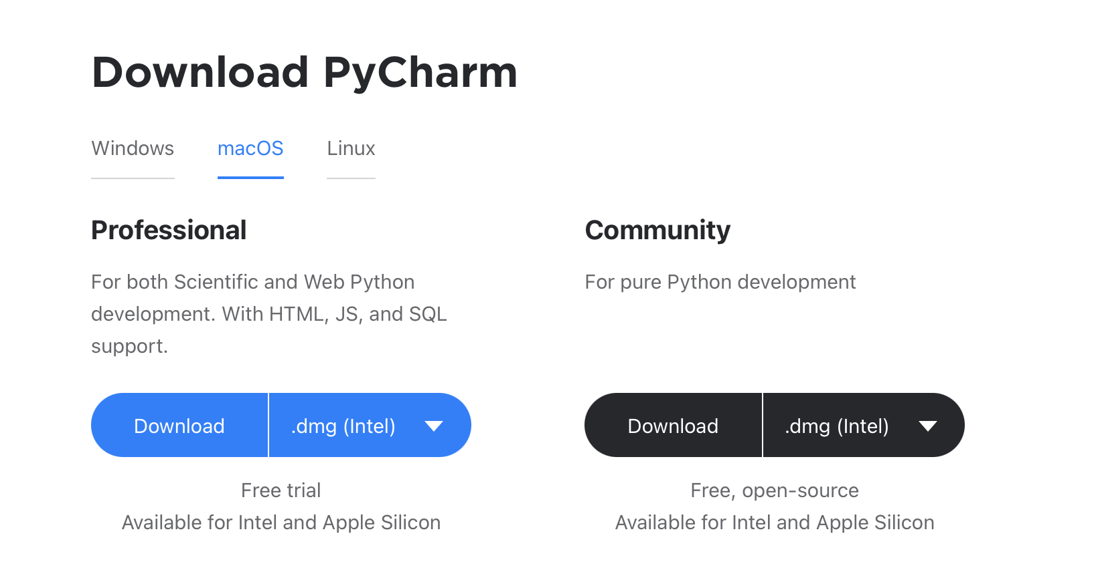
Downloading Pycharm Continued

Slide 7
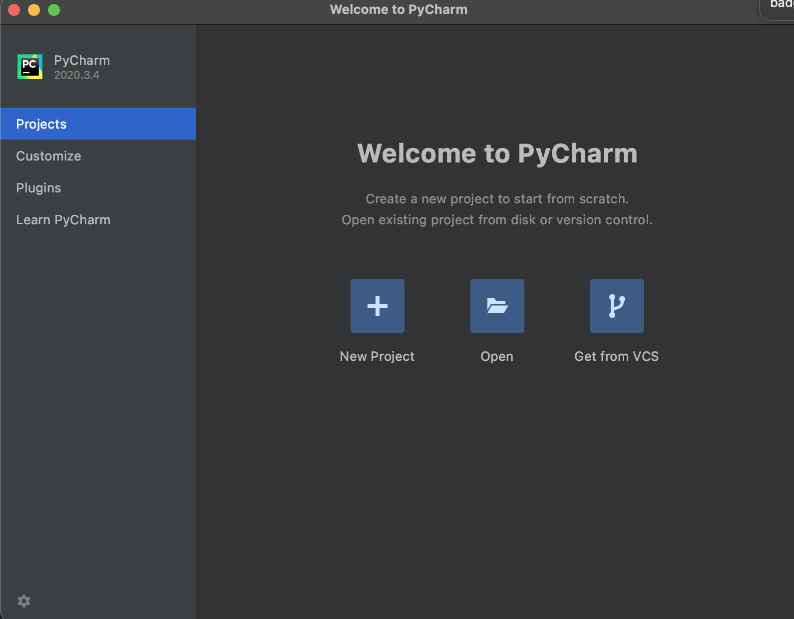
Working on Pycharm

Slide 8
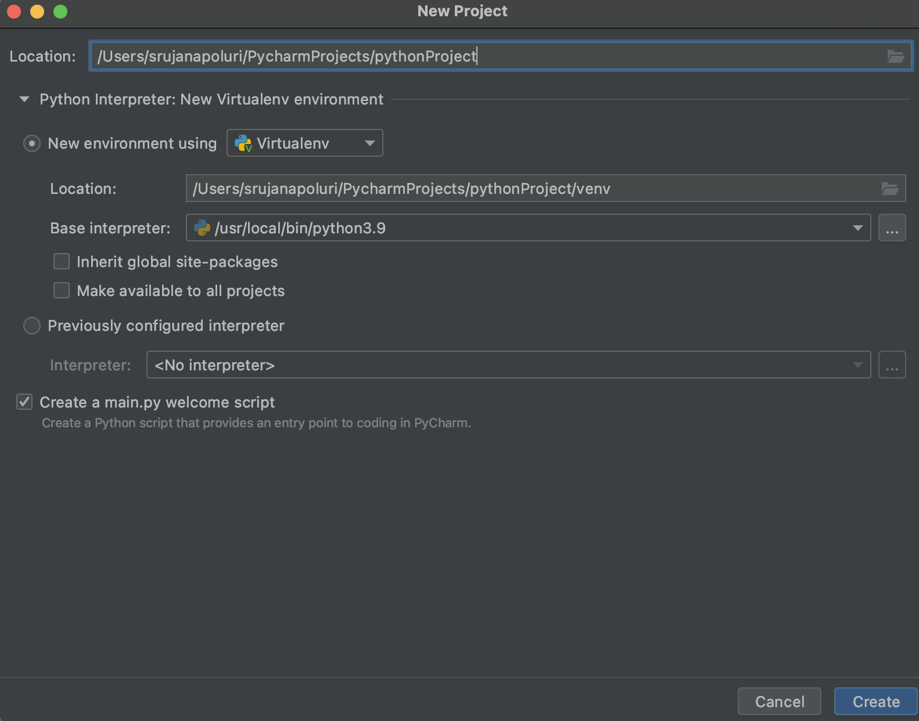

Slide 9
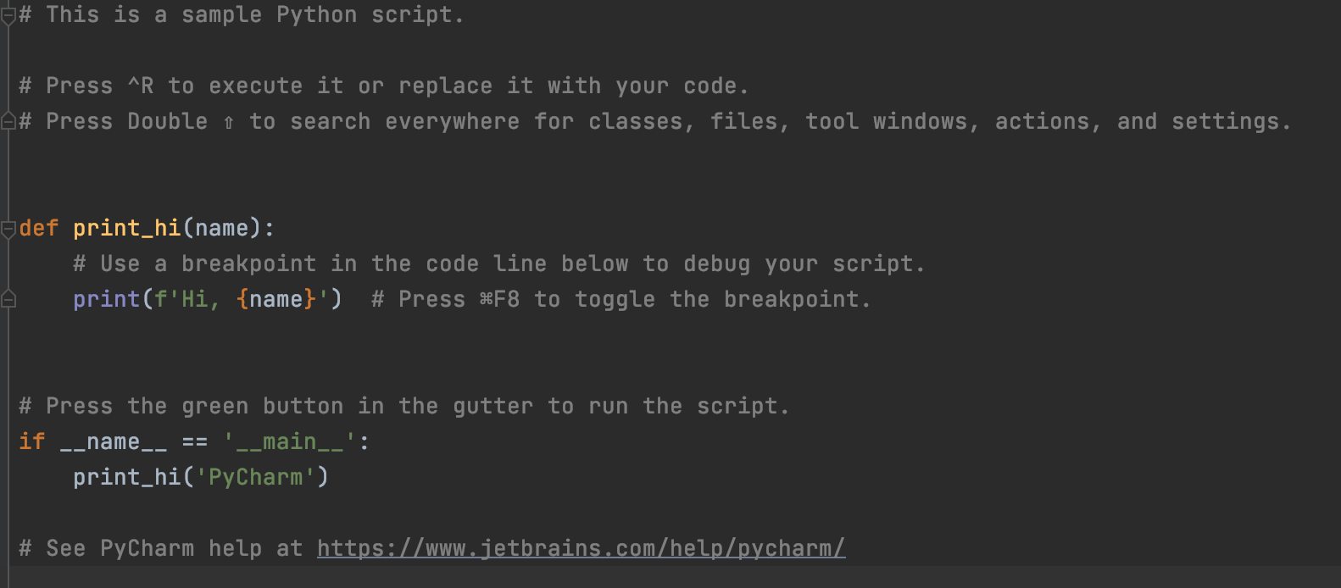

Slide 10
Let’s start coding!

Slide 11
Project 1: Calculator
Create a calculator using arithmetic operators and functions.
Should have addition, subtraction, multiplication, division functions
Depending on which function is called it should be able to take numbers and calculate
Bonus #1! If you can try to make functions that will do floor division.
Bonus #2! Try making another function for determining even or odd.

